Slide 1
Harnessing Predictive Analytics to Combat Telco Customer Churn Reducing Churn Rate up to 10%
Shafanda Nabil Sembodo
Dec 5, 2024

Slide 2
Disclaimer This presentation is mainly intended for CX Manager. Technical explanations are intentionally minimized to match the business stakeholder interest.

Slide 3
Executive Summary
In a telecommunication industry with high customer acquisition costs, addressing churn is crucial
As acquiring customers is 5x higher than retaining new ones.
High churn rates and costly customer acquisition can severely hinder a company's growth and profitability.
The current churn rate is 5% higher than the industry average of 21%, making a reduction imperative
Out of a total of 7,043 customers, 1,186 have left the company, resulting in a churn rate of approximately 26%.
This would require an investment CAC of approximately $823,084 in new customer.
Reducing the churn rate by 10% could significantly lower the costs associated with acquiring new customers.
By analysing customer churn based on behaviour enables a 8% reduction in churn rate
The proposed solution could reduce CAC by 62% or 2.6x more efficient.
The proposed solution highlights tenure and total charges as key predictors of customer churn.
Doing interventions on at-risk customers based on these features possible reduce churn rate to 18,5%.
This information is confidential and was prepared by our company; it is not to be relied on by any 3rd party without our prior written consent
Page 2

Slide 4

Customer churn: Key insights and business consequences
What is customer churn?
Customer churn happens when customers stop using a product or services, requiring the company to acquire new customers to maintain its base. With acquisition costs at $694 per person and retention at $173.3 per person*, high churn rates and costly acquisitions can hinder business growth and profits.
Costumer Acquisition Cost (CAC) is
5 x expensive than retention cost
*Reference link: Average CAC by industry
This information is confidential and was prepared by our company; it is not to be relied on by any 3rd party without our prior written consent
Page 3

Slide 5
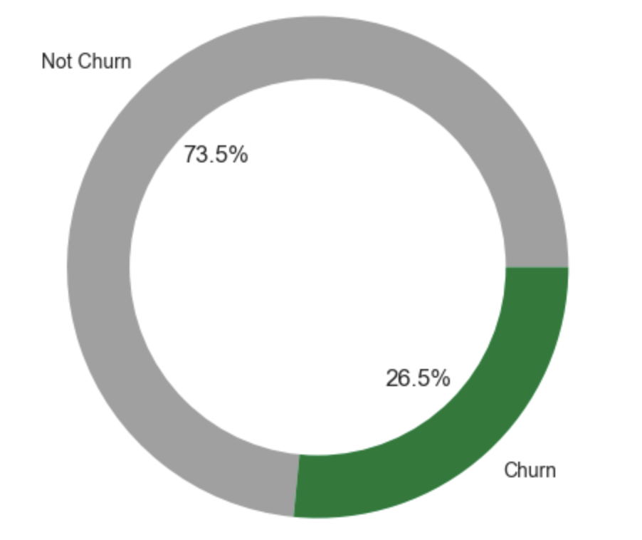
Our churn rate exceeded the 21% telco average, so we need strategy for significant reduction
How many customers left?
Churn vs non-churn customers (% of people)
Key Highlights
73.5%
Not Churn
Out of a total of 7,043 customers, and 1,186 have left the company. This represents a churn rate of approximately 26%.
To maintain the current customer base, the company would need to acquire at least 1,186 new customers
CAC: $694 x 1,186 customers = $823,084
This amount is ONLY for CAC to balance the revenue.
Effective churn reduction can significantly lower cost for acquiring new customers.
Total:
7043 Customers
26.5%
Churn
This information is confidential and was prepared by our company; it is not to be relied on by any 3rd party without our prior written consent
Page 4

Slide 6
What should we do now to reduce churn rate?
Goal & approach
Success measures
Goal
Reduce the churn rate by 10% to minimize our spending on CAC.
Approach
Analyze historical data to understand possible churn factors.
Build a classification model to flag at-risk customers.
Identify key factors influencing churn predictions.
Business metric
Churn rate: Percentage of customers who stop purchasing.
Machine learning metric
F5 score: Evaluates how effectively our model identifies customers are likely to churn, focusing on capturing as many potential churners as possible.
This information is confidential and was prepared by our company; it is not to be relied on by any 3rd party without our prior written consent
Page 5

Slide 7
Agenda
1
Churned customer profile: Evaluating customers’ demography, service subscriptions, billing & payment behaviors
2
Predictive model outcome: Understanding the best model’s performance predicting customer churn
3
Addressing customer churn: Exploring key factors contributing to customer churn
4
Recommendations: Essential steps to foster long-term customer commitment

Slide 8
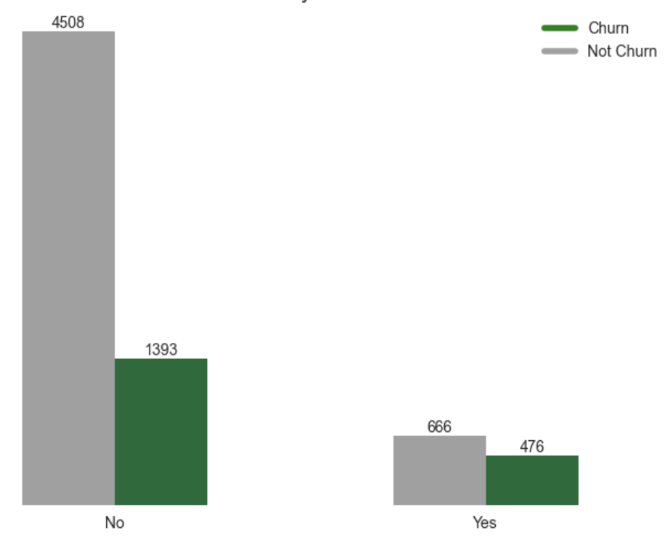
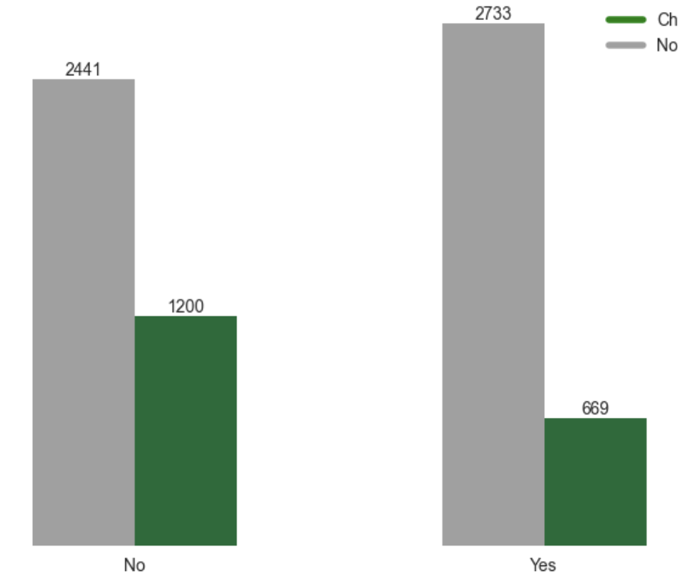
Who are the churned customers?
NOT CHURN | CHURN
They are senior citizen
They don’t have a partner
Churn proportion (in people) by senior citizen status
Churn proportion (in people) by partnership status
4508
2733
2441
1200
1393
666
669
476
Young Adult
Senior Citizen
Without Partner
Have a Partner
Senior citizens, comprising 1,142 customers, have a churn rate of 42% (476 churned), 1.7 times higher than non-senior citizens.
Of the 3,641 customers without partners, 1,200 churned, resulting in a 33% churn rate, 1.6 times higher than that of customers with partners.
This information is confidential and was prepared by our company; it is not to be relied on by any 3rd party without our prior written consent
Page 7

Slide 9
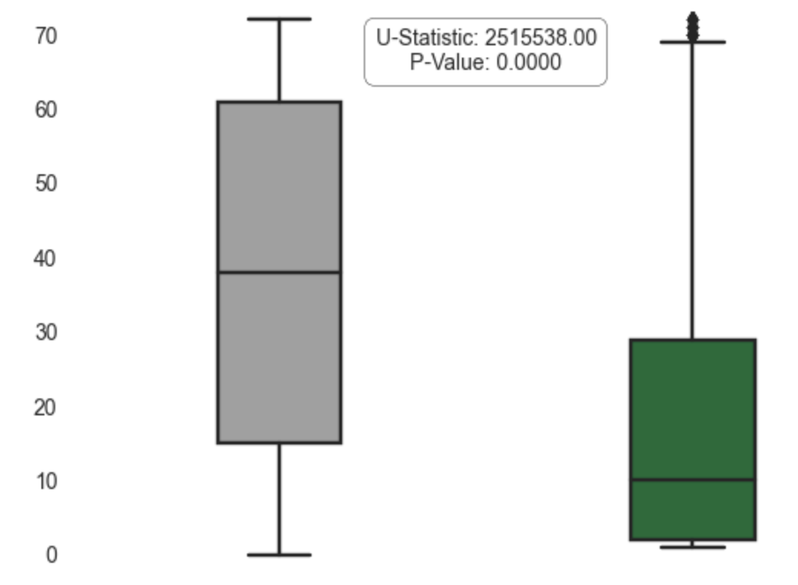
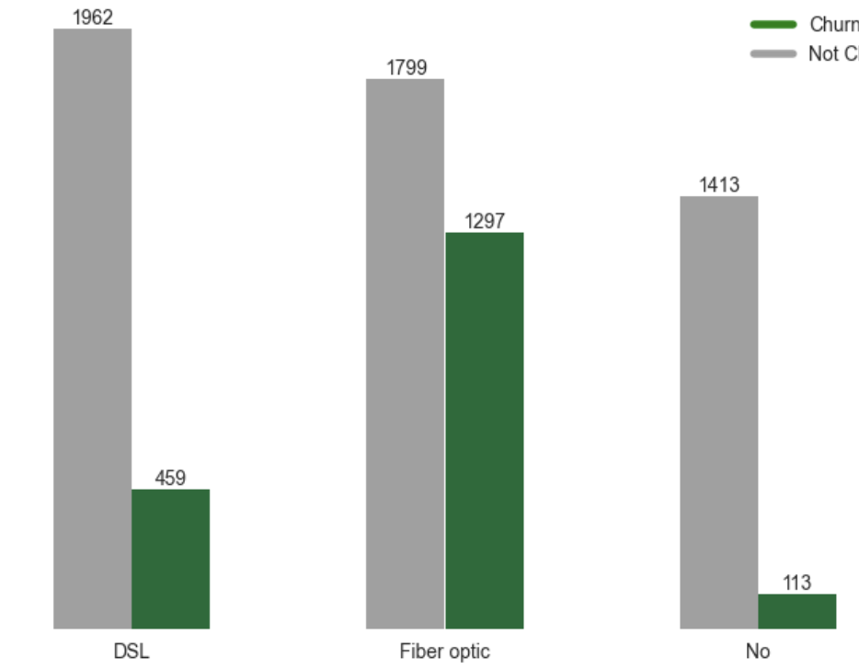
What services the churned customers uses?
NOT CHURN | CHURN
Shorter duration linked to churn
Fiber optic internet drives elevated churn
Tenure distribution (in month) by churn
Churn proportion (in people) by internet service usage
1962
1799
1413
1297
459
113
DSL
Fiber Optic
No
Churned customers have a median tenure that is 3.8 times shorter than that of non-churned customers.
Customers with fiber optic internet service show a much higher churn rate of 42%, with 1,297 churned customers out of 3,096.
This information is confidential and was prepared by our company; it is not to be relied on by any 3rd party without our prior written consent
Page 7

Slide 10
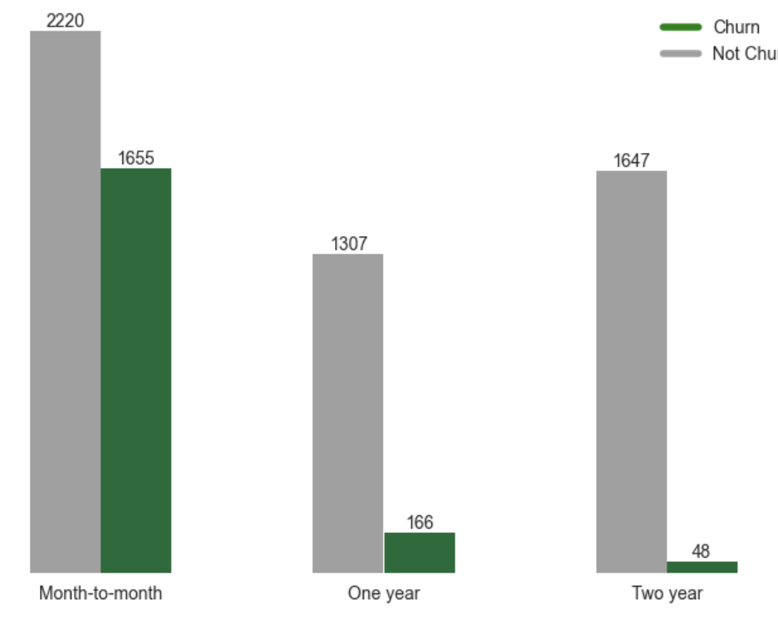
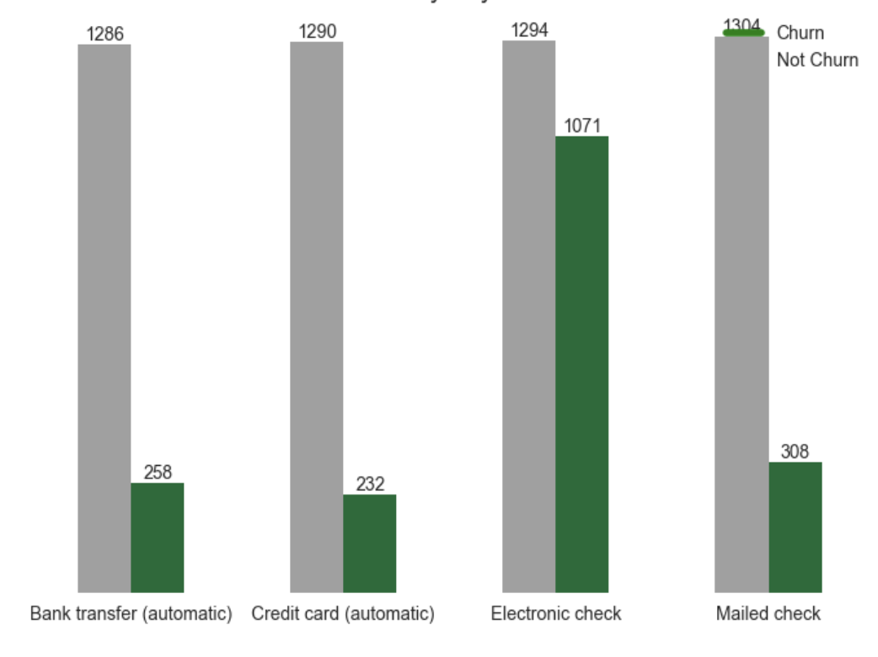
How do their transaction behaviors look like?
NOT CHURN | CHURN
High turnover in monthly contracts
Churn mostly from e-check payments
Churn proportion (in people) by contract type
Churn proportion (in people) by payment method
2220
1286
1290
1294
1034
1071
1655
1647
1307
258
308
232
166
48
Monthly
One Year
Two Year
Bank Transfer
Credit Card
Electronic Check
Mailed Check
Customers with month-to-month contracts have the highest churn rate at 43%, with 1,655 out of 3,875 discontinuing service.
Electronic check users face the highest churn rate at 45%, with 1,071 of 2,365 customers discontinuing their service.
This information is confidential and was prepared by our company; it is not to be relied on by any 3rd party without our prior written consent
Page 8

Slide 11
Agenda
1
Churned customer profile: Evaluating customers’ demography, service subscriptions, billing & payment behaviors
2
Predictive model outcome: Understanding the best model’s performance predicting customer churn
3
Addressing customer churn: Exploring key factors contributing to customer churn
4
Recommendations: Essential steps to foster long-term customer commitment

Slide 12
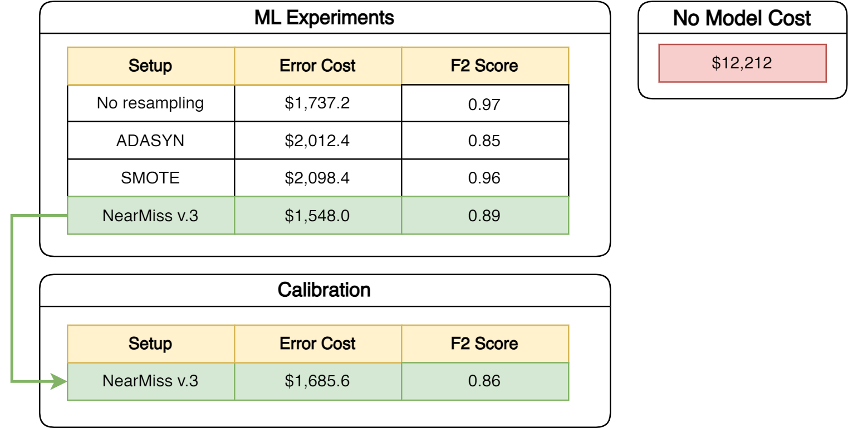
The proposed solution has the potential to achieve an 62% reduction in costs
We tested different models and evaluated using customer acquisition cost.
Using the uncalibrated model is 2.6x more cost efficient than without using the model.
It means, the model can save money up to $161,424.4
*
You might ask:
OK, the model is cost saving, but will it reduce our churn rate?
If so, how?
Let’s see our solution further!
**
*Adjustment on the model’s predictions for better reliability
**The error cost is calculated from the number of misclassifications and the CAC
This information is confidential and was prepared by our company; it is not to be relied on by any 3rd party without our prior written consent
Page 11

Slide 13
Agenda
1
Churned customer profile: Evaluating customers’ demography, service subscriptions, billing & payment behaviors
2
Predictive model outcome: Understanding the best model’s performance predicting customer churn
3
Addressing customer churn: Exploring key factors contributing to customer churn
4
Recommendations: Essential steps to foster long-term customer commitment

Slide 14
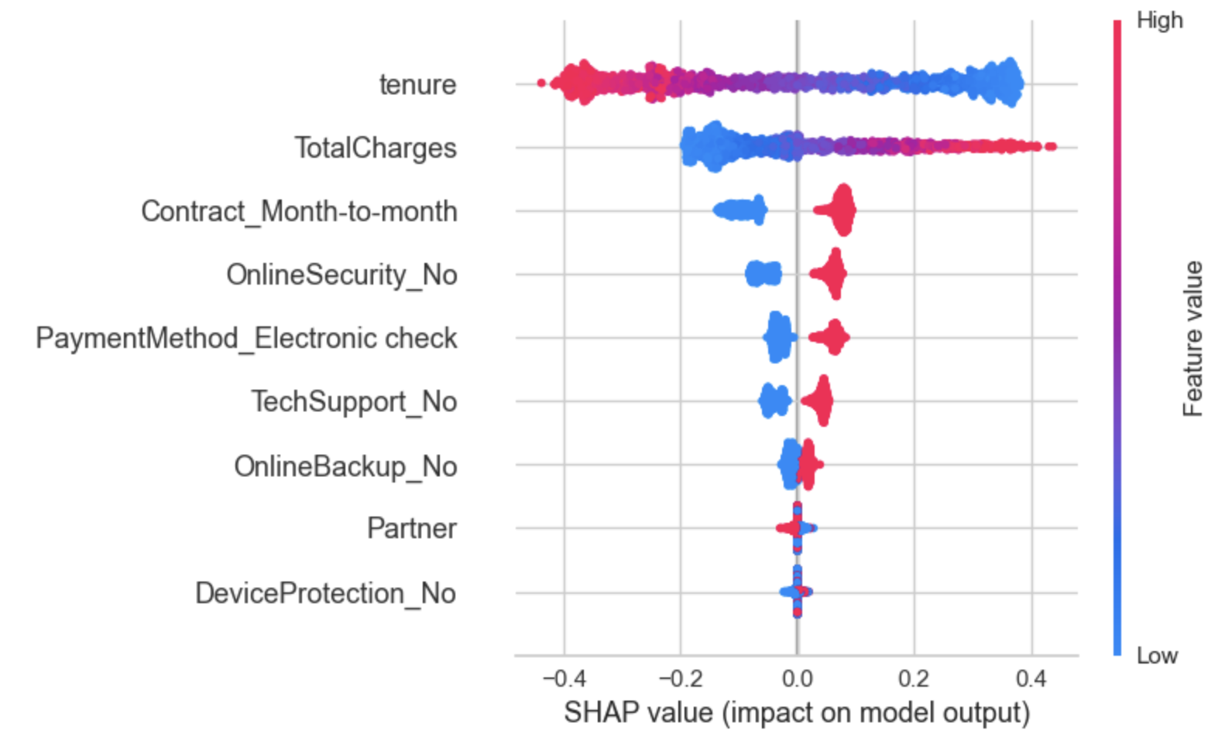
Shorter tenure and high total charges emerge as critical drivers of customer churn
55% factors are subscription-related
Key Highlights
Feature importance ordered based on SHAP value
Factors are ranked by their average impact on the model’s output.
Tenure, total charges, and contract (specifically month-to-month agreements) stand out as the most influential factors in the model's prediction of churn.
Leveraging insights from these influential factors, we can intervene tenure and the total charges on at-risk customers to prevent them from churning.
Not churn
Churn
This information is confidential and was prepared by our company; it is not to be relied on by any 3rd party without our prior written consent
Page 13

Slide 15


So, by strategically intervening in tenure or total charges will lead customer to not churn
Here, we attempt to demonstrate “If we change X, will Y change?” using a ML counterfactual explanation technique for tenure and cashback amount. For example, customer A is predicted to churn with a confidence rate of 0.63, then:
Option 1: Extend the contract duration to over 36 months
Option 2: Decrease the total charges to less than $716
Churn
Not Churn
Churn
Not Churn
Tenure: 36
Conf. Rate: 0.72
Total Charges: $316
Conf. Rate: 0.60
Tenure: 55
Conf. Rate: 0.92
Total Charges: $659
Conf. Rate: 0.54
Tenure: 18
Total Charges: $1,679
Tenure: 70
Conf. Rate: 0.98
Total Charges: $713
Conf. Rate: 0.53
This information is confidential and was prepared by our company; it is not to be relied on by any 3rd party without our prior written consent
Page 14

Slide 16
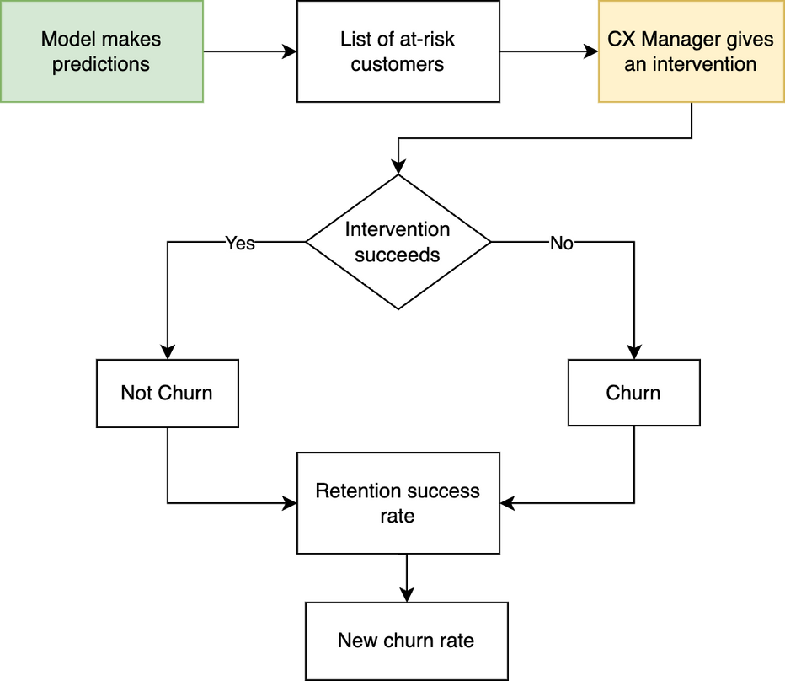
Finally, if we assume a 50% success rate for the intervention, then our company churn rate will drop below 21%
The success of implementation depends on the CX manager's strategy
Key Highlights
Detailed workflow for implementing the solution
In order the simulation of churn rate reduction to work, we need some assumptions:
Total customer: 10,000
Current churn rate: 0.265 (26.5%)
Predicted churners: 1,600
Retention success rate: 0.5 (50%)
Calculation
Current churners: 10,000 x 0.265 = 2,650
Retained churners: 2,650 x 0.5 = 1,325
New churners: 2,650 - 1,325 = 1,325
New churn rate: 1,325/10,000 = 0.185 (18.5%)
This information is confidential and was prepared by our company; it is not to be relied on by any 3rd party without our prior written consent
Page 15

Slide 17
Agenda
1
Churned customer profile: Evaluating customers’ demography, service subscriptions, billing & payment behaviors
2
Predictive model outcome: Understanding the best model’s performance predicting customer churn
3
Addressing customer churn: Exploring key factors contributing to customer churn
4
Recommendations: Essential steps to foster long-term customer commitment

Slide 18
Three strategic advice for customer experience managers
Recommendation
Objective
Rationale
High
Utilize predictive model
Flag at-risk customers to prevent churn
Model predictions can help target at-risk customers
Implement tiered rewards based on tenure
Reward long-term customers to encourage longer tenure
Churned customers have significantly shorter tenures.
Reevaluate online security, online backup, and device protection service
Customers who churn generally refuse to use the add-service
Ensure that customers use the add-service continuously
Low
This information is confidential and was prepared by our company; it is not to be relied on by any 3rd party without our prior written consent
Page 18

Slide 19
Thank You!

